Slide 1
Title of the business
Please make your presentation materials in English
Name of university
Name of team representative

Slide 2
Problem and Customer (especially, in the US)
Who is your customer?
What is the customer’s pain, especially how serious the problem is?
Describe the result of customer interview.

Slide 3
Solution
What is your product or service?
How does your product or service solve the customer’s pain by its unique value?
What is your technology seeds and its innovativeness?

Slide 4



Competitive Advantage (Data, Prototype, IP)
What is superiority and uniqueness against your competitors? How can you differentiate against your competitors? How is your IP protection?
How is your product advantageous against your competitors by showing quantitative comparisons with competing products?
Please show the prototype image based on your research outcomes.
Comparison | Your future product & service |  | Benchmark product & service
Competitive Advantage quantitatively | Fill in photographs and drawings of your prototype |  | Fill in photographs of Benchmark (major competitor)
Superiority and uniqueness as a means to realize products | Fill in the data showing uniqueness |  | Fill in Benchmark data
Pleases show the data currently available as your foundation.

Slide 5
Market Acquisition Strategy especially in the US
Define your market
  Major players and their future strategy
  SAM Market size: the number of the customer x target price of your product or service
  Its market growth
As the result, estimate SOM and target revenue.

Slide 6

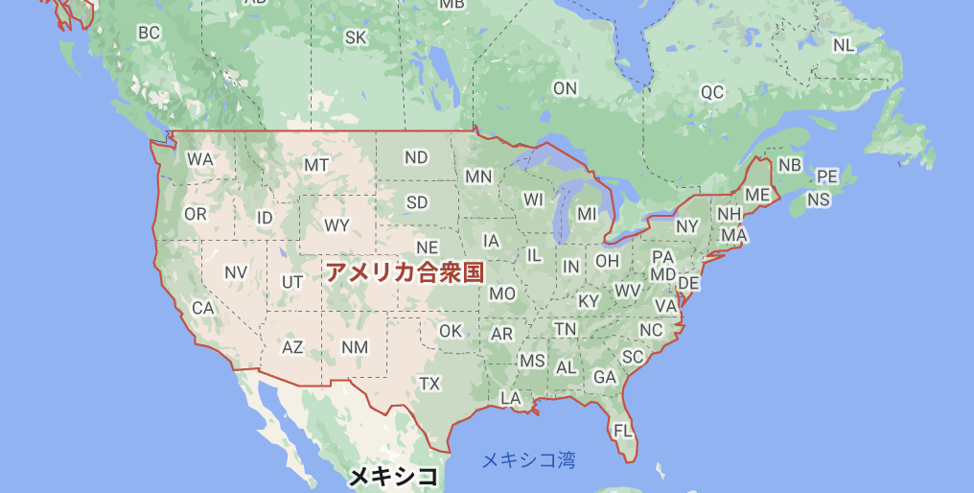
Partner Strategy, especially in the US
How to launch your business to realize your target revenue
  Business model you plan to use to enter the market
  Partner strategy
Who is your competitor B?
Who is your competitor A?
Who is your partner B?
Who is your partner A?

Slide 7
Go to Market
How to launch and sell the product or service.
Estimate your required resources (HR, Goods, Money and Time)

Slide 8
Your team and appeal for overseas staffs to join your team
The strength, role, and responsibility of each member in your current team
Appeal the attractiveness to participate in your team as EL or IM
(EL: Entrepreneurial Leader, lead the team and committed to commercialization
IM: Industrial Mentor, industrial expert with business experience)

