Slide 1
Title of the business
Please make your presentation materials in English
Research: Name of university, Name of research representative
CPO: Name of CPO, Name of CPO representative
(CPO: Commercialization Promotion Organization)

Slide 2
Problem and Customer (especially, in the US)
Who is your customer?
About the specific customer group. Being specific is key.
What is the customer’s pain, especially how serious is the problem?
About the challenges the customer has and how big is the problem. If possible, try to bring in metrics to describe the magnitude of the problem.
Describe the result of customer interview
How many users have you spoken to understand the problem space.
Who are they, what do they do, currently how do they solve the problem at hand.

Slide 3
Solution
What is your product or service?
How does your product or service solve the customer’s pain by its unique value?
Please show the prototype image based on your research outcomes.
Show a brief user journey of how your product or solution will help the user to solve their problem/challenge.
User journey - how does it look for the users while using the product or solution to solve their challenge.

Slide 4
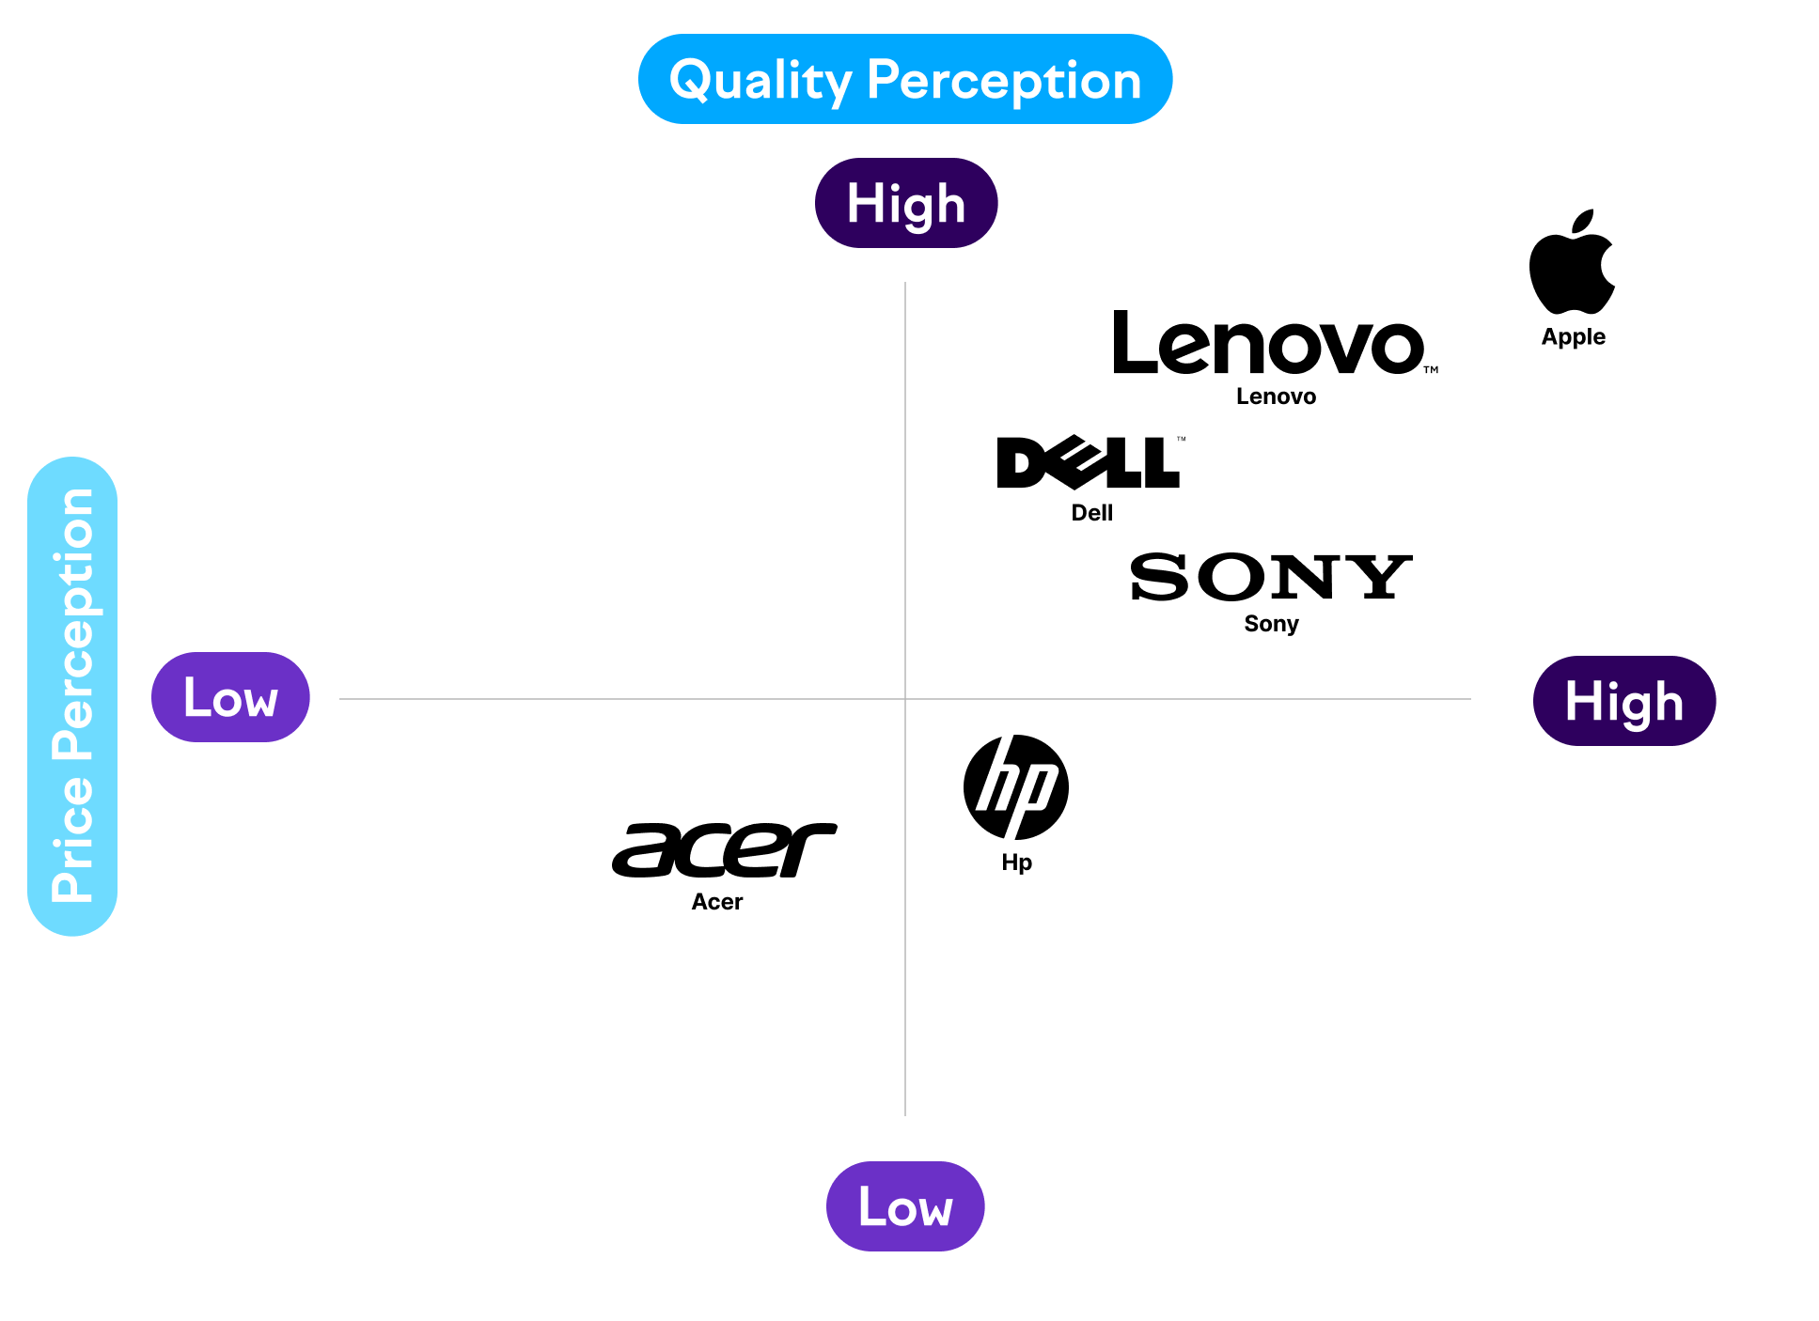
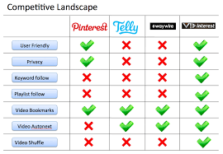
Competitive Advantage (Data, Prototype, IP)
What is superiority and uniqueness against your competitors?
How can you differentiate against your competitors? How is your IP protection?
How is your product advantageous against your competitors by showing quantitative comparisons with competing products?
  Pleases show the data currently available as your foundation.
Tell us about similar solution in the market. Your close competitors. What is their offering compared to yours. How are you different from your competitors.
Examples

Slide 5
Market Analysis
Define your market
Major players and their future strategy
How big is the market you are targeting. What is the revenue of current close competitors or similar products or solutions.
How many users are you targeting in the coming time (ex. quarterly projections).
Price that you are looking at having your solutions. If there is any categories or Tiers in pricing, mention that.
What is the revenue you envision to reach over a period of time. (Be as specific as possible, this is more of vision of revenue for a specific timeline.)

Slide 6
Milestones
Goals and milestones at the end of September this year
      Overall goals
  Business goals
  Technology goals
Goals and milestones at the end of March next year
  Overall goals
    Business goals
    Technology goals
    Team building goals
  Milestone in terms of user interviews, product development, MVP rollouts, outreach to potential partners/collaborators/users, etc.

Slide 7
Team
The strength, role, and responsibility of each member in your current or future team
Tell about your team (each member) their roles and responsibilities in the team (title) and expertise.
Mention any advisors or mentors you have. University support or clubs that had supported you in this venture.

